Slide 1




LOST THE BOUNCE IN YOUR BUNGEE?
A Grounded Theory Study into Compassion Fatigue and Burnout in the Coaching Profession
Rosefield, M. (2023)
Coaching Psychology
Conference 8th & 9th June 2023

Slide 2

Notes:
Interactive, please shout out, ask questions in the chat – I’d love to know before we begin, what you’d like to know and then I can tailor what I cover.

Slide 3
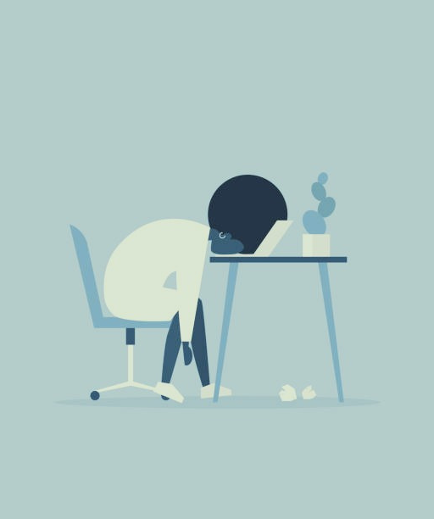

Definitions
Compassion can be defined as concern for the sufferings or misfortunes of others, the feeling of being moved by the distress of another, and by the desire to relieve it
(Oxford English Dictionary, 2021)
This desire to help, may lead to fatigue or exhaustion in the caretaker; a fatigue so profound it is understood by some to be an unavoidable casualty of the desire to help.
(C. Figley, 2017; C. R. Figley, 1995; C. R. Figley & Decety (Ed.), J, 2011)
Burnout can be defined as a “prolonged response to chronic interpersonal stressors on the job” demonstrated as fatigue, detachment, cynicism, and ineffectiveness/lack of accomplishment at work.
(Maslach & Leiter, 2016, p103).

Slide 4


Purpose
Why it matters
Gap in the Literature - no empirical research existed
Research Me-search
Impact of the phenomena - Brain scans, statistics
To help other coaches to avoid, navigate &/or recover from Compassion Fatigue and/or Burnout
To highlight both the risk and protective factors to the wider coaching profession
"self as an instrument"
Bachkirova T, 'The Self of the Coach: Conceptualization, Issues and Opportunities for Practitioner Development'Consulting Psychology Journal 68 (2) (2016) pp.143-156

Slide 5
Statistics
86%
OF 'HELPING WORKERS' PERCEIVE INCREASED STRESS FROM HELPING
IN SOCIAL SERVICES FIELDS
23%
SHOW SYMPTOMS OF EMOTIONAL EXHUASTION
15%
AT RISK OF SECONDARY TRAUMA
Hricova, Monika & Lovašová, Soňa. (2019). STRESS, SECONDARY TRAUMA AND BURNOUT-RISK CHARACTERISTICS IN HELPING PROFESSIONS a. 161-165.
Notes:
Purpose - Why it matters
Gap in the Literature - no empirical research existed
Impact of the phenomena - Brain scans, statistics
To help other coaches to avoid, navigate &/or recover from Compassion Fatigue and/or Burnout
To highlight both the risk and protective factors to the wider coaching profession

Slide 6
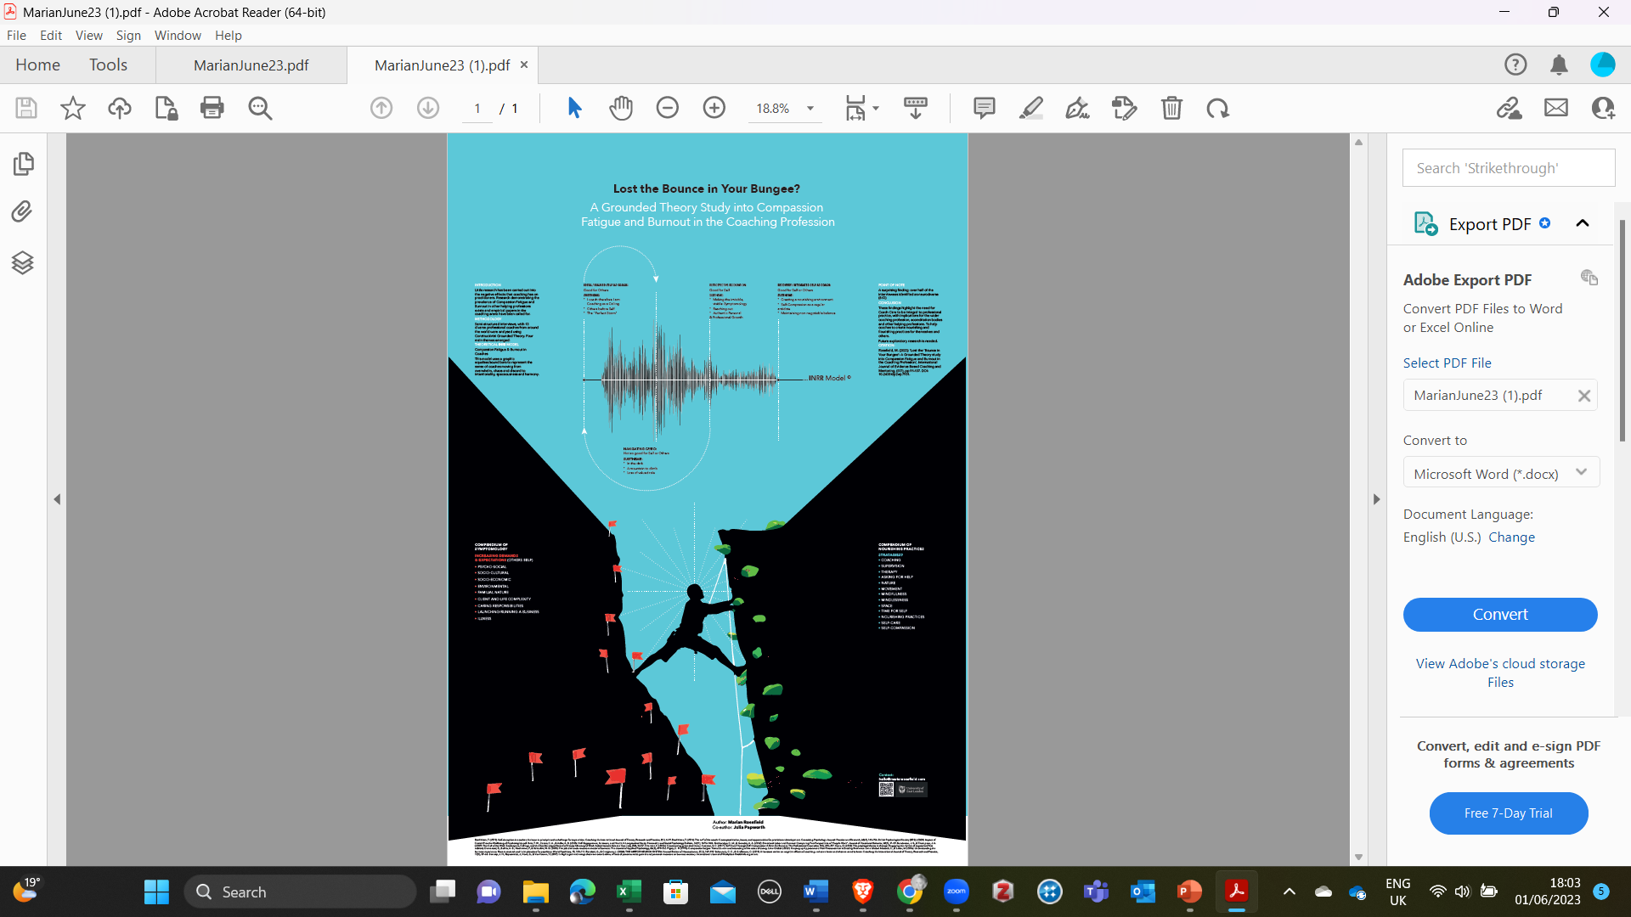
Poster Presentation
A whistle-stop tour of the research journey ...

Slide 7
Poster Presentation

Slide 8
Poster Presentation

Slide 9
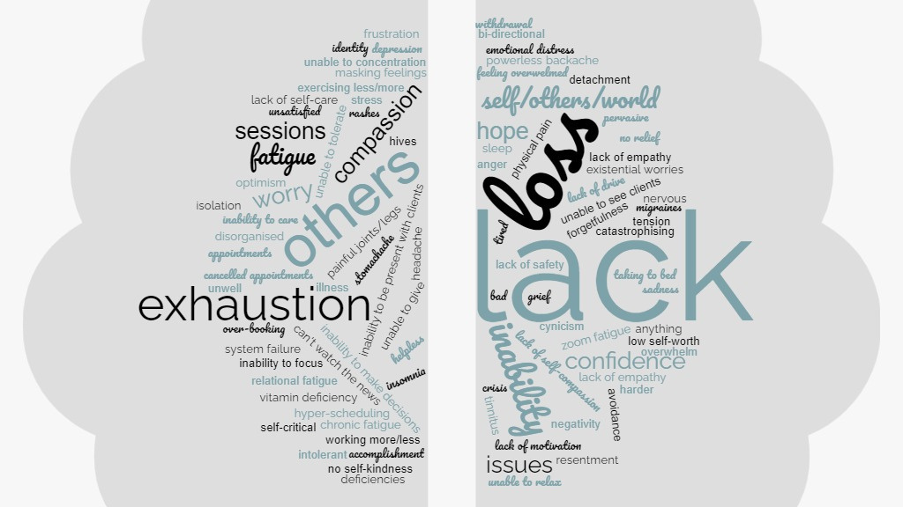
Symptomology

Slide 10
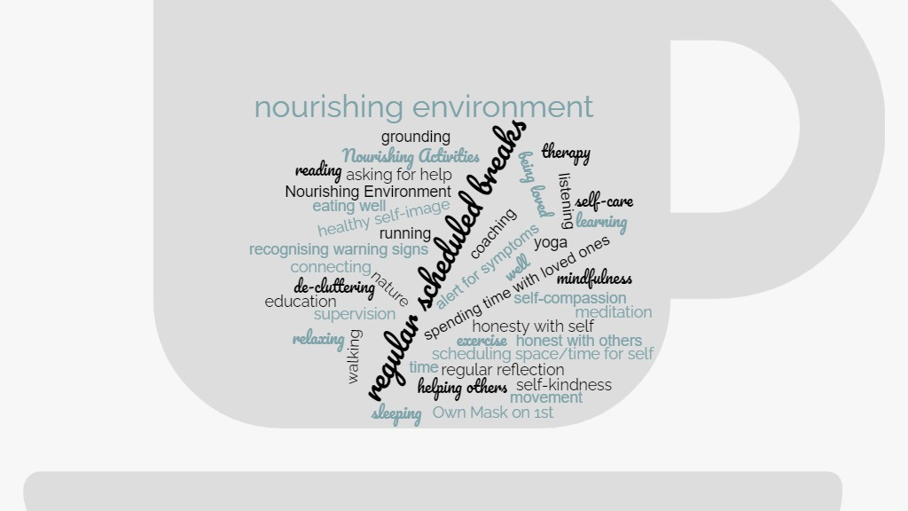
Recovery

Slide 11

















Recovery: Integrated Self as Coach: Good for Self & Others
Retrospective Recognition: Good for Self
  Making the invisible, visible: Symptomology
  Reaching out
  "Significant Lifestyle Changes”
  Creating a Nourishing Environment
  Self-Compassion as a regular antidote
  Maintaining non-negotiable balance
Ideal/Valued Self as Coach: Good for Others
  I coach therefore I am; Coaching as a Calling
  Others before Self
  The “perfect storm”
INRR Model
of
Compassion Fatigue
& Burnout
in Coaches
Navigating CF/BO: Not so good for Self or Others
  In the dark
  A mountain to climb
  Loss of valued role

Slide 12







Compassion Fatigue and Burnout are occurring in the Coaching Profession.
Points of Note & Recommendations
Cynicism as highlighted in the Stages of Burnout in Coaches (Bachkirova, 2016), appeared mainly in an organisational context.
Once aware of their Coaching Shadow and understand the risks they undertake, Coaches may be forewarned and forearmed.
Over 50% of the Coaches interviewed identified as neurodiverse.
lf a coach suspects they are experiencing compassion fatigue, or for a yearly 'health check' they can use the free Professional Quality of Life measure developed by psychologist
Beth Hudnall Stamm, PhD.
Co-creating conversations about risk, prevention and recovery in training, supervision and CPD, with Coach Care at its heart.
Further research is needed.
** For more see article https://doi.org/10.24384/p2wj-7931

Slide 13


Conclusion
LOST THE BOUNCE IN YOUR BUNGEE?
3 Key Findings:
  How Compassion Fatigue and Burnout impact Coaches and their ability to coach.
  How Coaches Navigate this experience.
  How Coaches recover and continue to coach (or not).
Limitations:
  Researcher bias
  Small sample size

Slide 14







"Now I'm much more boundaried and protective of my time and try not to give too much. I think there's something about having compassion for yourself, for those boundaries and the fact that they are hard won" Kai
Words of Wisdom
Putting your own oxygen mask on first is crucial as "once you get into a state of Burnout, it is a very long journey back out of it. Lee
"Compassion fatigue is like the early warning sign, like a lighthouse and you know you're going to get dashed against the rocks if you don't keep a bit of distance" Luca
Burntout
Coaches have a responsibility to themselves and their clients to consistently commit to attending to their own wellbeing. Luca

Slide 15

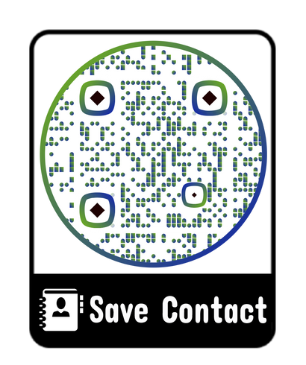
If you have any questions or to continue the conversation, either send a message to hello@marianrosefield.com
or
connect with me on
/marianrosefield/

Slide 16
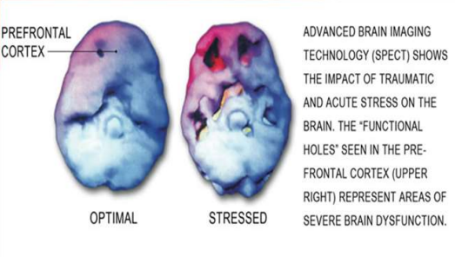
Neuroscience
IMPACT OF ACUTE STRESS
Introduction & Why it matters
Definitions
Findings & Model
Conclusion & Recommendations
Thanks, Let's Stay Connected, then Q&A
Walton M, Murray E, Christian MD. Mental health care for medical staff and affiliated healthcare workers during the COVID-19 pandemic. European Heart Journal: Acute Cardiovascular Care. 2020;9(3):241-247. doi:10.1177/2048872620922795

Slide 17


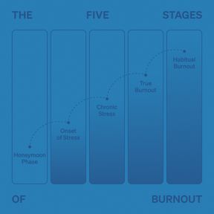
Potentially related theories:
  Polyvagal Theory (Porges, 2009)
  Neuroscience: Mirror Neurons (Glaser, 2014)
Potential Risk Factors:
  Personality (Alcaron, Eschleman & Bowling, 2009)
  Coping styles/Perfectionism (de la Fuente et al., 2020)
  Environmental variables (Panagioti et al., 2017)
Potential Mitigating Factors:
  Strong Support Network (Howard & Johnson, 2004)
  Stress Management/Coping (Scanera et al., 2009)
  Self-compassion (Neff and Costigan, 2014; Collins, 2014)
  Strengths Based Mindfulness (Krasner, 2009)
Literature Review

Slide 18

Method
Interviews &
Transcripts
15 Semi-structured Interviews with 13 Coaches
Analysed and coded using NVivo and off-line creative methods
Core Themes
to Theoretical
Model
Constructivist
Grounded
Theory
Sharmaz (2006)
Coding: Initial
& Focused
Model created with four Emergent Themes
Model calibrated by re-interviewing two of the Coaches
Theoretical
Sampling
Memo
Writing
  Charmaz, Kathy. 2006. Constructing Grounded Theory.

Slide 19


Findings
Symptomology:
  Physical
  Psychological
  Emotional
  Relational
Recovery:
  Physical
  Psychological
  Emotional
  Relational
COMPASSION FATIGUE & BURNOUT CONTINUUM
Burnout
Compassion
Fatigue
Struggle
Health
Flourish

Slide 20
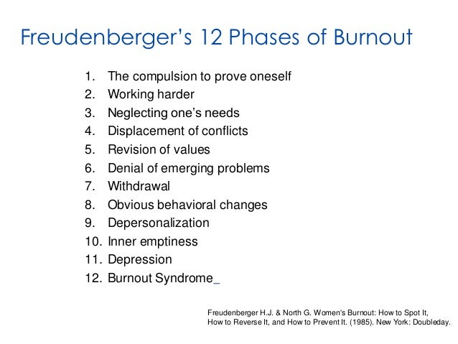
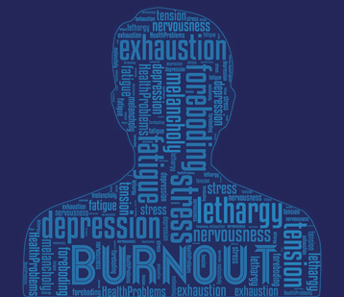
FREUDENBERGER'S 12 PHASES OF BURNOUT

Slide 21
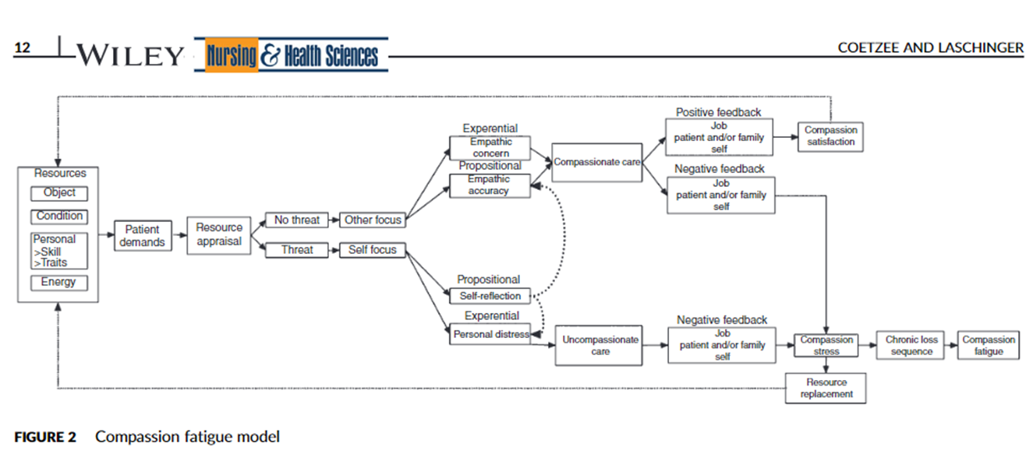
https://onlinelibrary.wiley.com/doi/epdf/10.1111/nhs.12387?saml_referrer

Slide 22





Eating or sleeping too little or too much
Have you felt any of these?
Having low energy / exhausted
Feeling unusually confused or overwhelmed
Finding it difficult to connect with others & becoming resentful
lf a coach suspects they are experiencing compassion fatigue, or for a yearly 'health check' they can use the free Professional Quality of Life measure developed by psychologist Beth Hudnall Stamm, PhD.
Inability to perform daily tasks

Slide 23
References
  Bachkirova T, 'The Self of the Coach: Conceptualization, Issues and Opportunities for Practitioner Development'Consulting Psychology Journal 68 (2) (2016) pp.143-156
  Oxford English Dictionary, 2021
  Figley, Charles R. 1995. ‘Compassion Fatigue: Toward a New Understanding of the Costs of Caring’. Pp. 3–28 in Secondary traumatic stress: Self-care issues for clinicians, researchers, and educators.
  Figley, Charles R. 2011. ‘The Empathic Response in Clinical Practice: Antecedents and Consequences.’ Pp. 263–74 in The Social Neuroscience of Empathy: From Bench to Bedside
  Maslach, Christina, and Michael Leiter. 2016. ‘Understanding the Burnout Experience: Recent Research and Its Implications for Psychiatry’. World Psychiatry15:103–11. doi: 10.1002/wps.20311.
  Walton M, Murray E, Christian MD. Mental health care for medical staff and affiliated healthcare workers during the COVID-19 pandemic. European Heart Journal: Acute Cardiovascular Care. 2020;9(3):241-247. doi:10.1177/2048872620922795
  Hricova, Monika & Lovašová, Soňa. (2019). STRESS, SECONDARY TRAUMA AND BURNOUT-RISK CHARACTERISTICS IN HELPING PROFESSIONS a. 161-165.
  Charmaz, Kathy. 2006. Constructing Grounded Theory. London ; Thousand Oaks, Calif: Sage Publications.
  Porges, Stephen W. 2009. ‘The Polyvagal Theory: New Insights into Adaptive Reactions of the Autonomic Nervous System’. Cleveland Clinic Journal of Medicine 76(Suppl 2):S86–90. doi: 10.3949/ccjm.76.s2.17.
  Glaser, Judith E. 2014. Conversational Intelligence: How Great Leaders Build Trust and Get Extraordinary Results.
  Alarcon, Gene, Kevin J. Eschleman, and Nathan A. Bowling. 2009. ‘Relationships between Personality Variables and Burnout: A Meta-Analysis’. Work & Stress 23(3):244–63. doi: 10.1080/02678370903282600.

Slide 24
References
  de la Fuente, Jesús, Francisca Lahortiga-Ramos, Carmen Laspra-Solís, Cristina Maestro-Martín, Irene Alustiza, Enrique Aubá, and Raquel Martín-Lanas. 2020. ‘A Structural Equation Model of Achievement Emotions, Coping Strategies and Engagement-Burnout in Undergraduate Students: A Possible Underlying Mechanism in Facets of Perfectionism’. International Journal of Environmental Research and Public Health 17(6):2106. doi: 10.3390/ijerph17062106
  Panagioti, Maria, Efharis Panagopoulou, Peter Bower, George Lewith, Evangelos Kontopantelis, Carolyn Chew-Graham, Shoba Dawson, Harm van Marwijk, Keith Geraghty, and Aneez Esmail. 2017. ‘Controlled Interventions to Reduce Burnout in Physicians: A Systematic Review and Meta-Analysis’. JAMA Internal Medicine 177(2):195. doi: 10.1001/jamainternmed.2016.7674
  Howard, Sue, and Bruce Johnson. 2004. ‘Resilient Teachers: Resisting Stress and Burnout’. Social Psychology of Education 7(4):399–420. doi: 10.1007/s11218-004-0975-0.
  Scarnera, Pasquale, Andrea Bosco, Emanuela Soleti, and Giulio E. Lancioni. 2009. ‘Preventing Burnout in Mental Health Workers at Interpersonal Level: An Italian Pilot Study’. Community Mental Health Journal 45(3):222–27. doi: 10.1007/s10597-008-9178-z.
  Neff, Kristin D., and Andrew P. Costigan. 2014. ‘Self-Compassion, Wellbeing, and Happiness’. 6.
  Collins, Sophia. 2014. ‘Exploring Psychologists’ Attachment Style, Compassion Fatigue and Satisfaction, and Use of Self-Care within Forensic Settings.’ University of Hertfordshire.
  Krasner, Michael S. 2009. ‘Association of an Educational Program in Mindful Communication With Burnout, Empathy, and Attitudes Among Primary Care Physicians’. JAMA 302(12):1284. doi: 10.1001/jama.2009.1384.

Slide 25

ONLINE
GROUP
COACHING
PROGRAMME
hello@marianrosefield.com

Slide 26





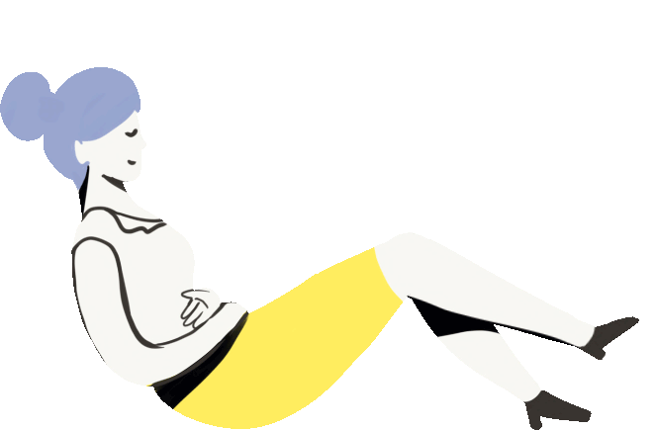

Experience of Compassion Fatigue & Burnout
Recovery:
Integrated Self as Coach
Presence with client
Retrospective Recognition
Ideal/valued Self as Coach

